Slide 1
CIS CONTROL 18: APPLICATION SOFTWARE SECURITY-I
APPLICATION SOFTWARE SECURITY

Slide 2
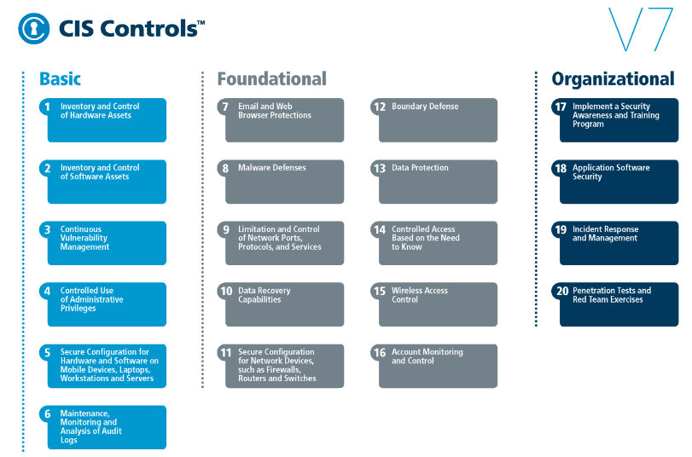
CIS CONTROL 18: APPLICATION SOFTWARE SECURITY-I
https://www.cisecurity.org/controls/

Slide 3
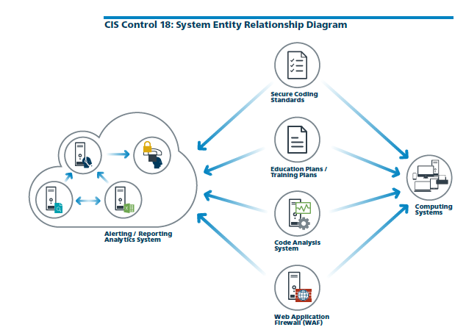
CIS CONTROL 18: APPLICATION SOFTWARE SECURITY-I
https://www.cisecurity.org/controls/

Slide 4
CIS CONTROL 18: APPLICATION SOFTWARE SECURITY-I
18.1: Establish Secure Coding Practices
Establish secure coding practices appropriate to the programming language and development environment being used.

Slide 5
CIS CONTROL 18: APPLICATION SOFTWARE SECURITY-I
18.2: Ensure Explicit Error Checking is Performed for All In-house Developed Software
For in-house developed software, ensure that explicit error checking is performed and documented for all input, including for size, data type, & acceptable ranges or formats.

Slide 6
CIS CONTROL 18: APPLICATION SOFTWARE SECURITY-I
18.3: Verify That Acquired Software is Still Supported
Verify that the version of all software acquired from outside your organization is still supported by the developer or appropriately hardened based on developer security recommendations.

Slide 7
CIS CONTROL 18: APPLICATION SOFTWARE SECURITY-I
18.4: Only Use Up-to-date And Trusted Third-Party Components
Only use up-to-date and trusted third-party components for the software developed by the organization.
END

